Slide 1
MongoDB with Node and Angular
Node Routes for MongoDB
Angular Service and Component for MongoDB

Slide 2
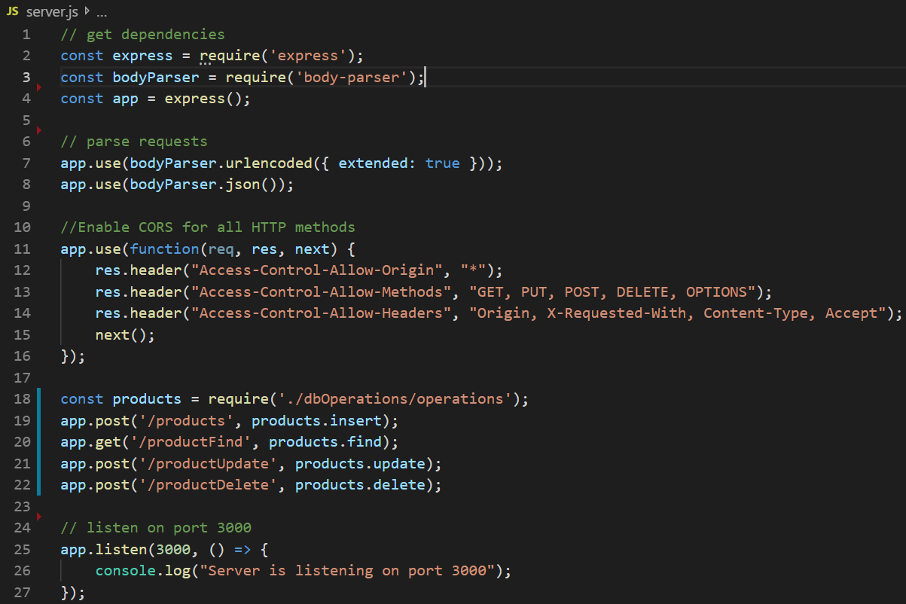
Node Routes for MongoDB
To define Node Routes for MongoDB, we create server.js and operations.js file. As shown below, there are four routes in server.js.

Slide 3
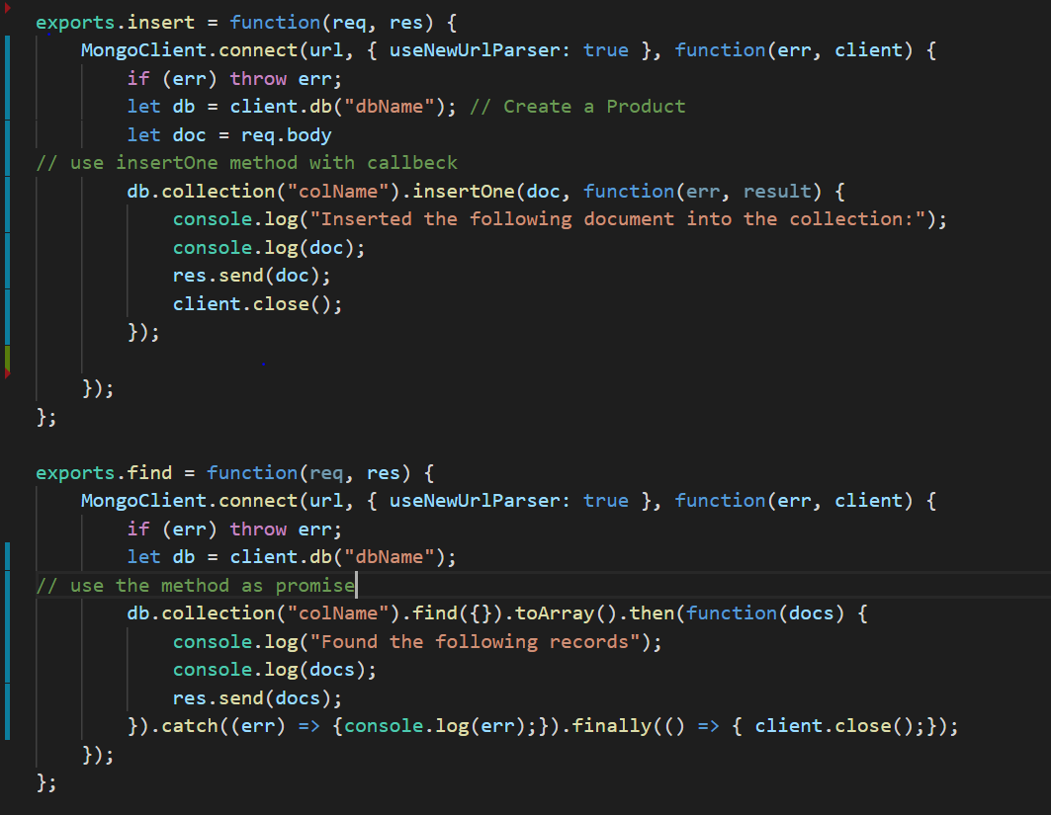
Node Routes for MongoDB
The operations.js exports four four functions: insert, find, and update and delete. The node driver provide database operations with both callback and as promises.

Slide 4
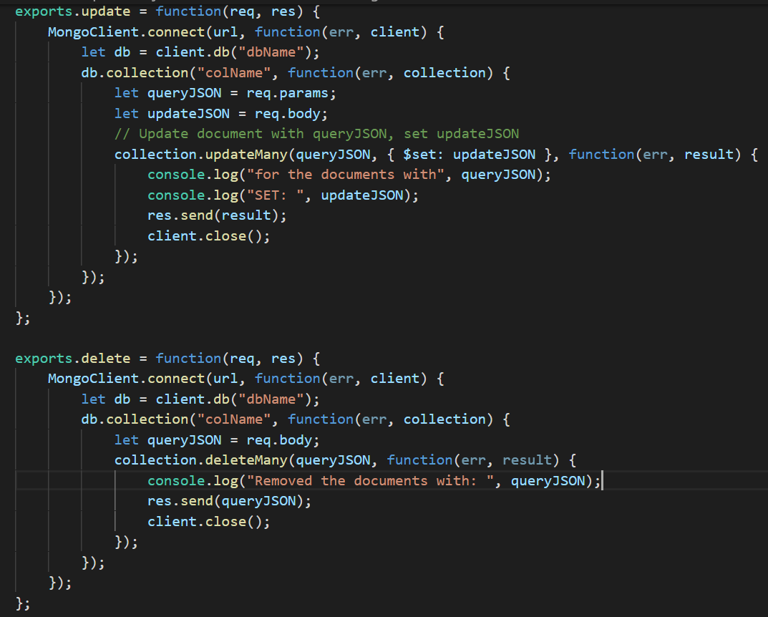
Node Routes for MongoDB
We may test the four node routes by postman.

Slide 5
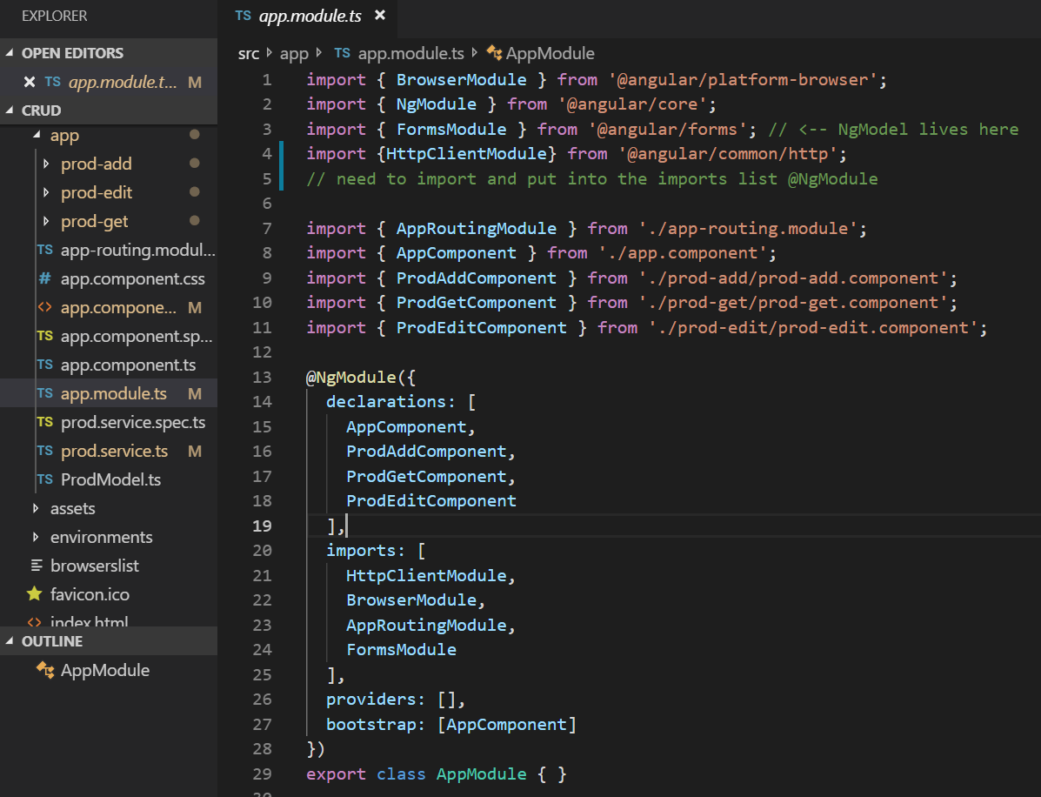
Angular Structure
Our angular project will have 3 page components: prod-add, prod-edit and prod-get. Also, we have a prod-service.ts for httpClient services.

Slide 6
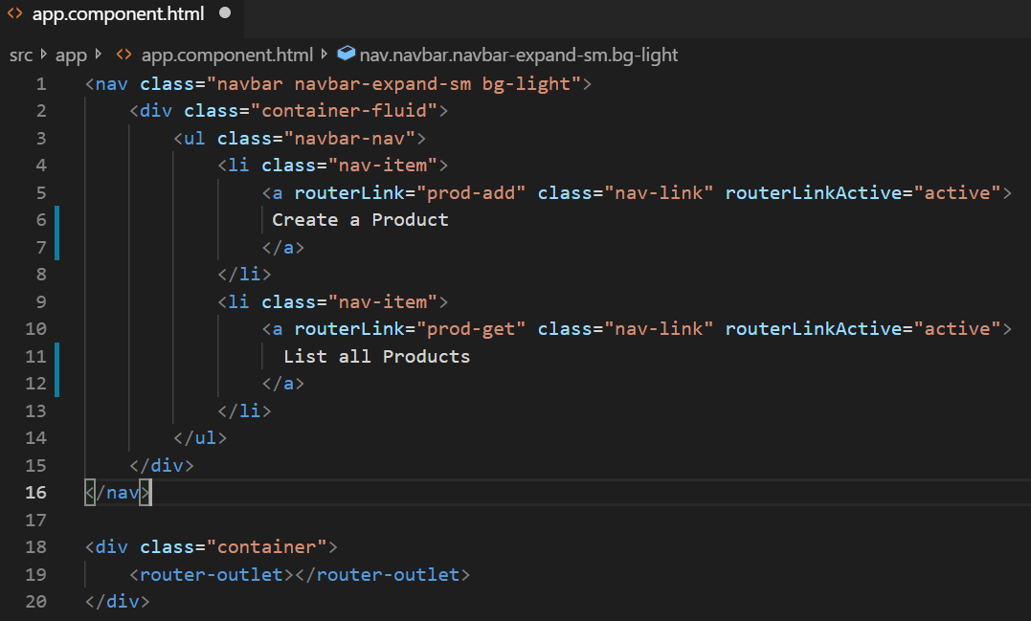
Create Navbar in app.component.html
Write the following code inside the app.component.html file as navbar. There are buttons in the navbar to navigate to pages prod-add and pro-get

Slide 7
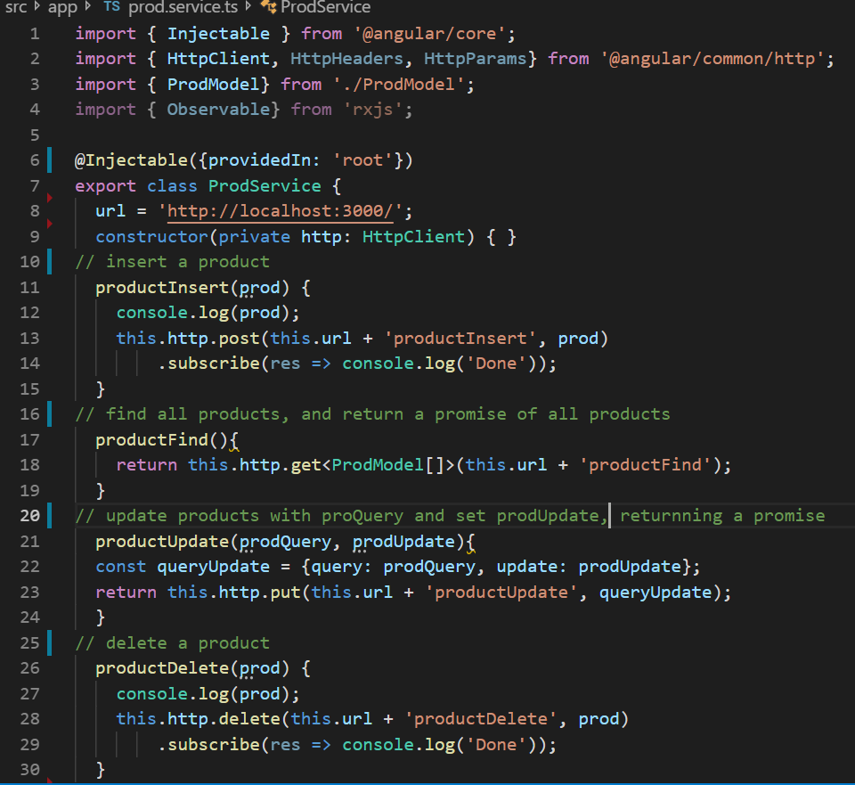
Create an Angular Navigation
In prod.service.ts, http services are created related to the routes in the backend.

Slide 8
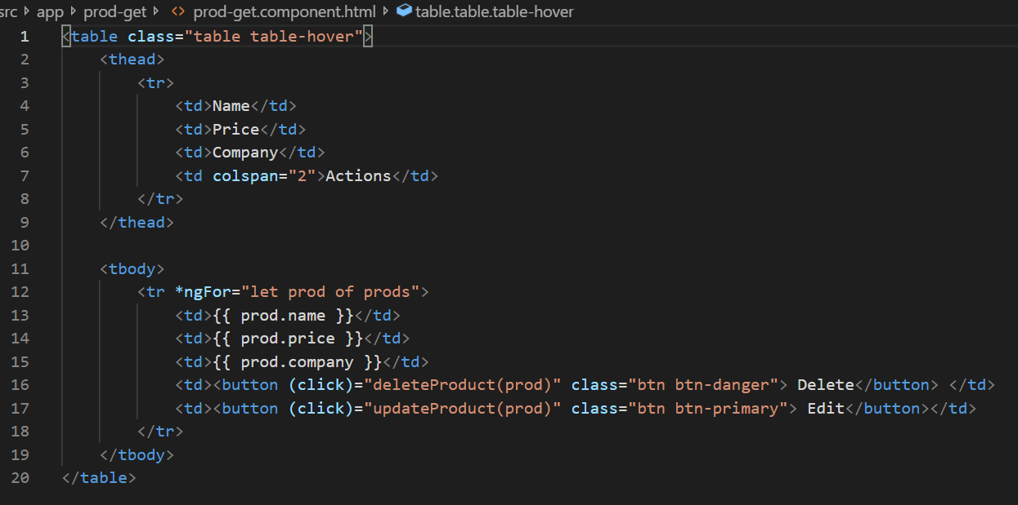
To Display Products as a Table
We may display all products as a table in prod.get.component.html, where two functions deleteProduct(prod) and updateProduct(prod) are define in ts file

Slide 9
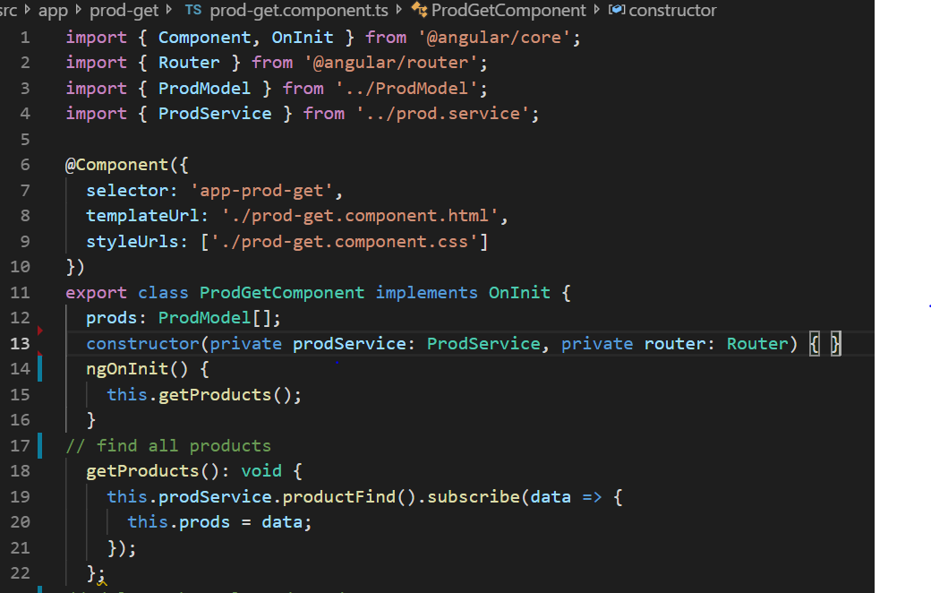
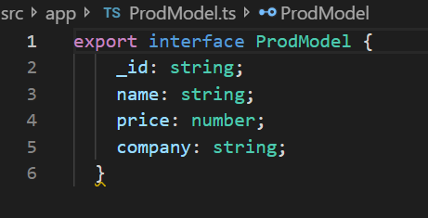
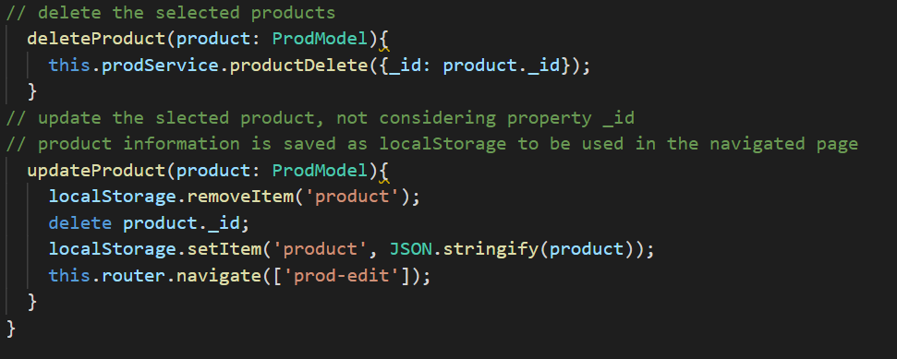
Functions getProducts(), deleteProduct() and updateProduct
Functions getProducts(), deleteProduct() and updateProduct in pro-get page

Slide 10
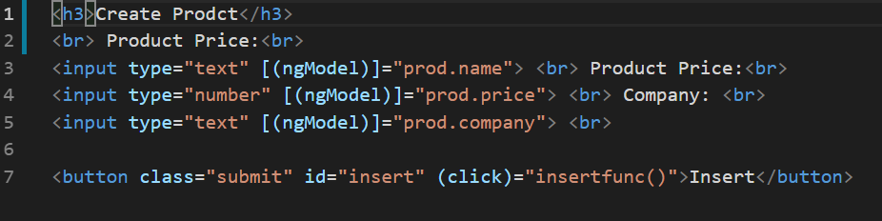
The html file for prod-add Componet
The html for prod-add can be simply as below, where function insertfunc() can be defined in ts file by using method productInsert of ProdService

Slide 11
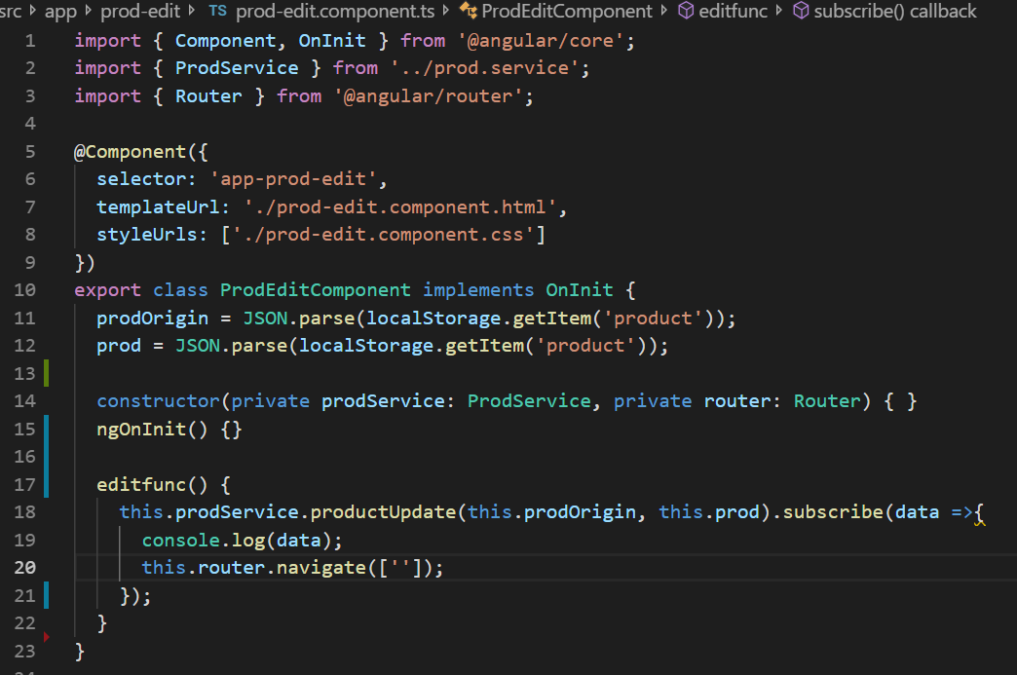
The ts file for prod-edit Componet
The ts file for prod-edit component can be as below; while
the html can be similar as the same for prod-add.

Slide 12
MongoDB with Angular
https://github.com/zeptobook/Angular7CRUD
https://www.zeptobook.com/how-to-create-restful-crud-api-with-node-js-mongodb-and-express-js/

